Slide 1




VANGUARD’S A/B TESTING
By
Kaveri and Shubham

Slide 2
Data cleaning and merging | Data overview and EDA | KPI | Hypothesis testing | Evaluation | Visualisation in Power Bi/ Streamlit
PROJECT OVERVIEW
6
5
4
3
2
1
A brief history of a quirky design

Slide 3
INTRODUCTION
Vanguard recently introduced a new user interface featuring enhancements like cues, messages, hints, and instructions. Our goal is to analyze whether these changes can make the online process smoother and encourage more clients to complete the process.
To achieve this, an experiment was conducted with two groups-
Users with the traditional online platform
Users with the new digital UI

Slide 4
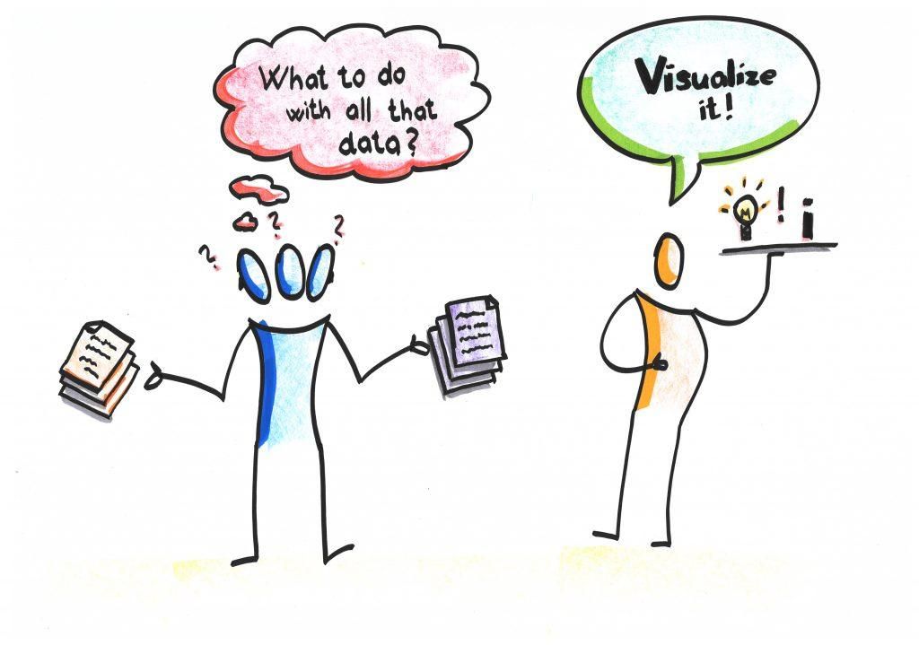

DATA OVERVIEW
We were provided with 3 dataset
Customer profile
Web details
The experiment roster
Data cleaning and merging
Null values
Outliers(age)

Slide 5

EXPLORATORY DATA ANALYSIS (EDA)
Overall demographics
We have carried out univariate analysis here for both
control and test group.
Client behaviour analysis
We have carried out bivariate analysis here for both
control and test group.

Slide 6
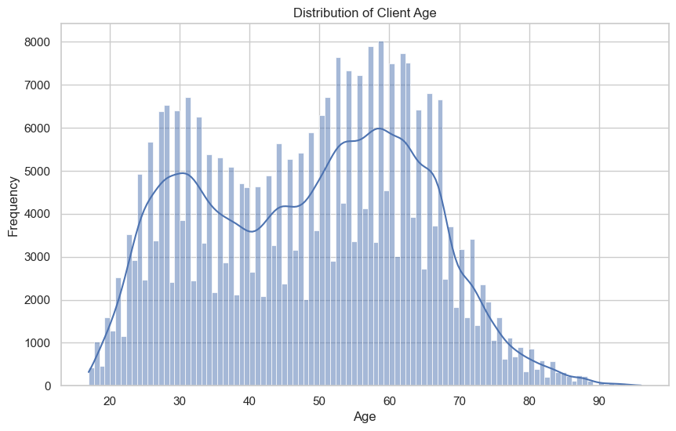
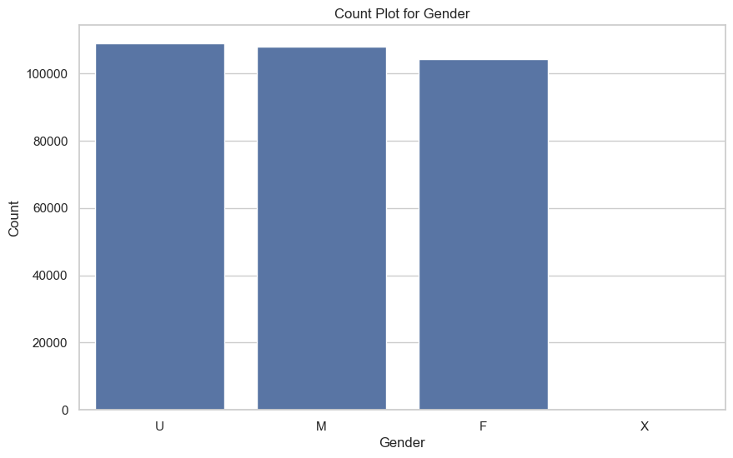
OVERALL DEMOGRAPHICS

Slide 7
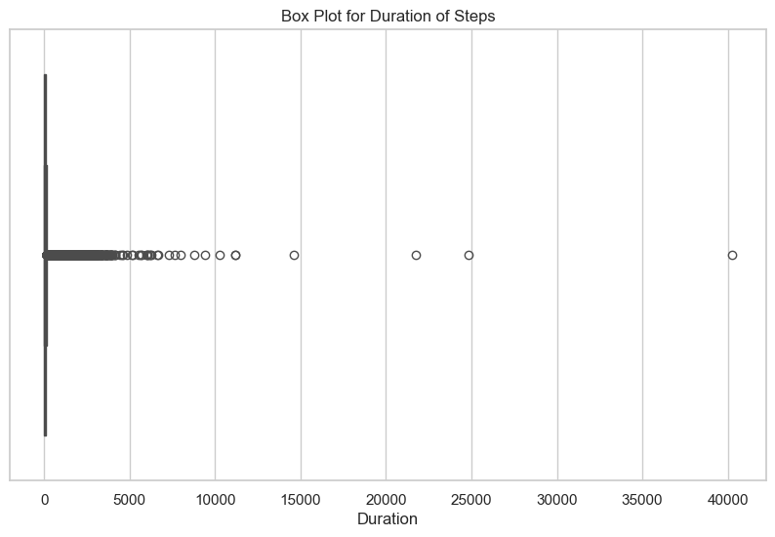
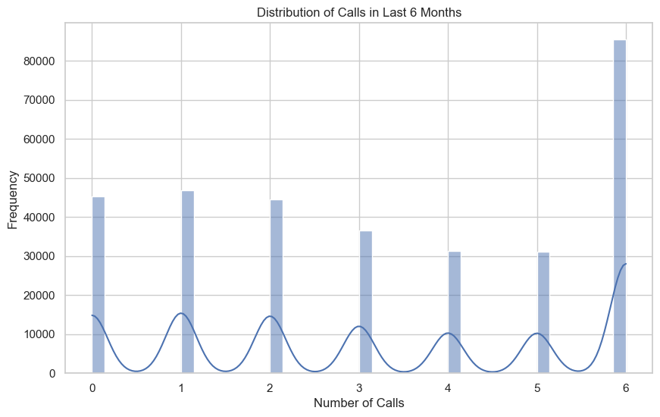

Slide 8
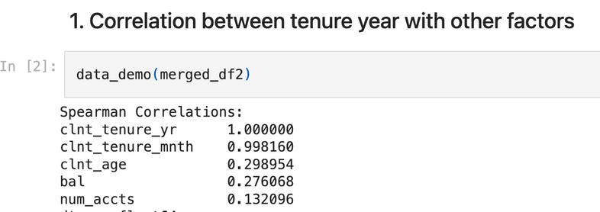
CLIENT BEHAVIOUR ANALYSIS
Who are the primary customers?
After careful consideration, Tenure year, client age, gender as the most significant ones which might have a direct impact on the success rate(confirm step) and how they are related.

Slide 9
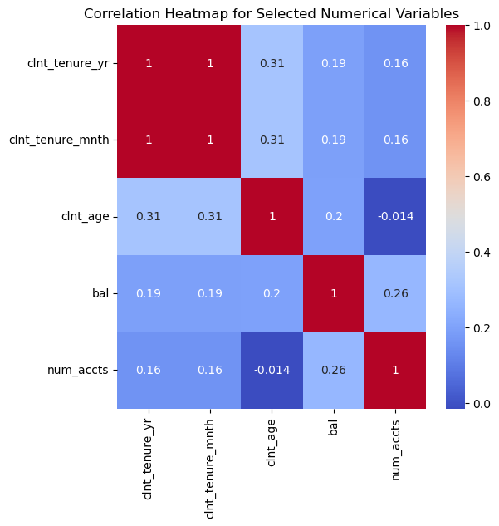
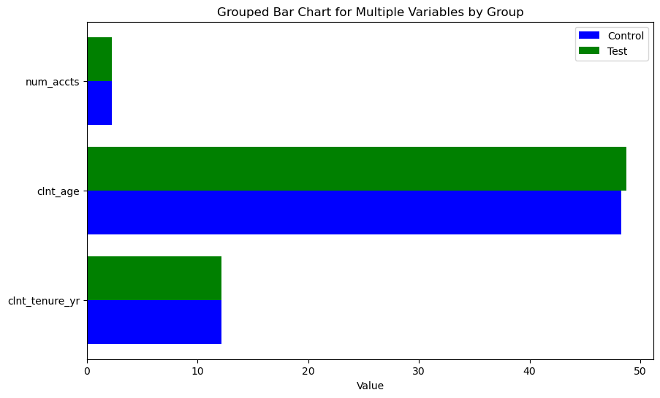

Slide 10
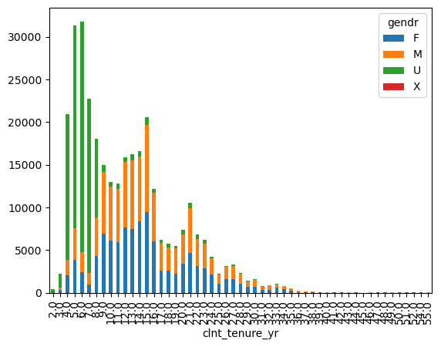

Slide 11
KPI & HYPOTHESIS
Completion Rate
Time Spent on Each Step
Error Rates

Slide 12
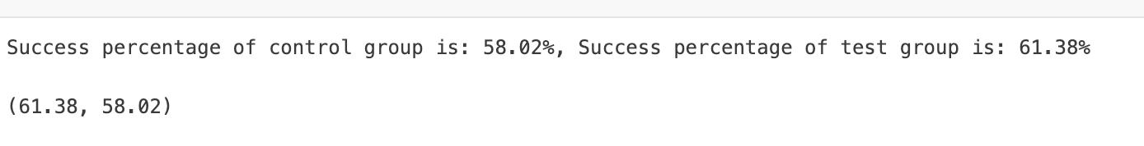
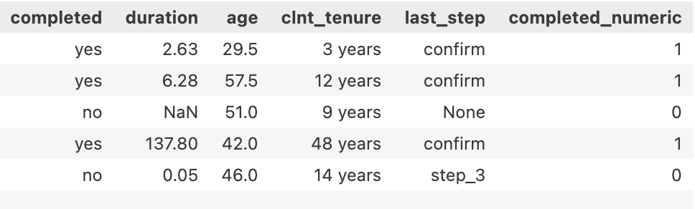
COMPLETION RATE

Slide 13
HYPOTHESIS- 1
H0 = Control group success rate = Test group success rate
H1= Control group success rate != Test group success rate
T-Statistic: -8.130156856984316
P-Value: 4.3755383431637894e-16
Insight-Since the p-value is much lower, (typically ≤ 0.05)it indicates strong evidence against the null hypothesis. conclude that the mean success rate of the test group is significantly different than that of the control group.

Slide 14
HYPOTHESIS- 1
H0 = Control group success rate > Test group success rate
H1= Control group success rate < Test group success rate
T-Statistic (greater): 8.137324196769077
P-Value (greater): 2.0614046907717007e-16
We can conclude that the mean success rate of the test group is significantly greater than that of the control group.

Slide 15
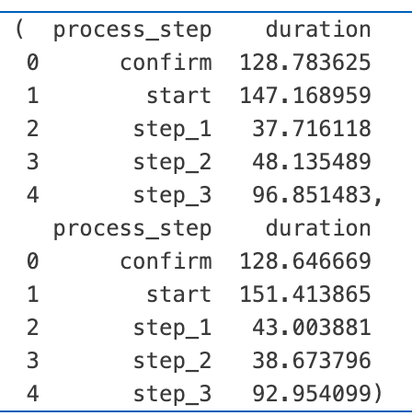
TIME SPENT ON EACH STEP

Slide 16

HYPOTHESIS- 2
H0 -The total average duration for the test group < control group.
H1- The total average duration for the test group > control group.
significance level = 0.05
We can conclude that, the average duration for the test group is significantly greater than the average duration for the control group.

Slide 17



STEPS | TRADITIONAL | UPDATED UI | COMMENTS
START |  |  | initial interface or instructions in the test group required more time to understand or navigate.
STEP 1 |  |  | Test version either had more content or was less intuitive, leading to longer interaction times.
STEP 2 |  |  | This suggests that users found this step easier or quicker to complete in the test group, possibly due to improved interface design or clearer instructions.
STEP 3 |  |  | -Do-
CONFIRM |  |  | Whatever changes were tested did not affect the duration of this step.

Slide 18
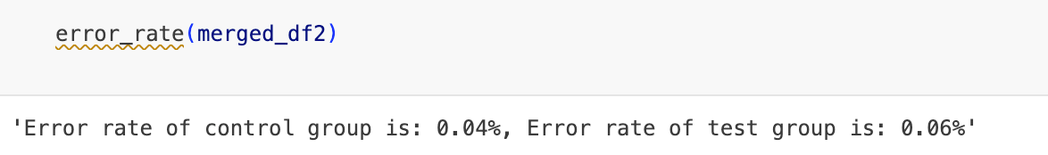
ERROR RATE

Slide 19
HYPOTHESIS- 3
H0 -The error rate of the test group < control group.
H1- The error rate of the test group > control group.
significance level = 0.05
The very low P-value and high T-statistic suggest that this difference is statistically significant, indicating that the new version introduced in the test group has a meaningful impact on error rates.

Slide 20
HYPOTHESIS- 3
Consider moving from a later step to an earlier one as an error.For each group, the error rate is calculated as the proportion of these “error” instances to the total number of steps taken.
But, when it comes to error rate , users performing on the modern UI has higher percentage of going back on the previous pages.

Slide 21
Insight/Probable reasons-
1. it could be either to review some information they previously saw, such as product details, specifications, or terms and conditions.
2. When comparing products, services, or content, users may go back and forth between pages to evaluate their options.
3. Mismatch in Content: If the content on the page does not meet the user's expectations or is not relevant, they may go back to the previous page to find what they're looking for.
4. Unclear Page Functionality: If users are unsure about how to interact with a page or complete a task, they might go back to start over or reconsider their actions.If users find the content uninteresting or not engaging, they may simply go back and look for something else.
5. Lack of Clear Next Steps: If the next steps are not clearly indicated or if the call-to-action buttons are not prominent, users might go back to seek further guidance. They might go back to explore other options if they are uncertain about their decision.

Slide 22
EXPERIMENT EVALUATION
The experiment design, discussing the randomization, duration, and potential biases.
Randomization- Participants (or units, such as website visits) are randomly assigned to either the control group (which experiences the standard version) or the test group (which experiences the new intervention or variation).
Duration- The experiment has been carried out for 3 months, for both the groups, which, samples were equally distributed to both the groups.
Bias- If there had to have enough details on the steps/pages, the experiment would have provided better analysis as in what led users to stck in /go back to one step.

Slide 23
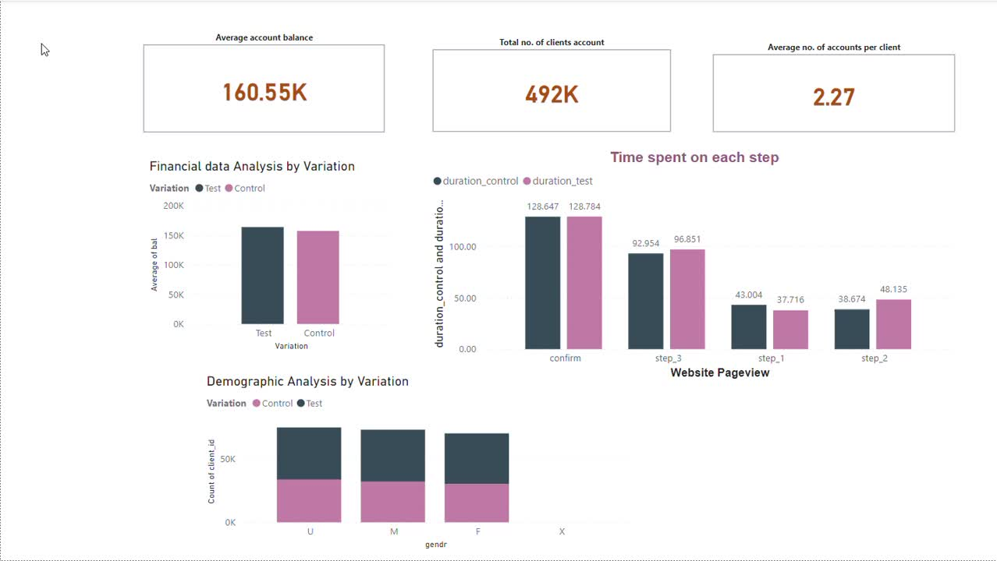
DASHBOARD- POWER BI

Slide 24

DASHBOARD- STREAMLIT

Slide 25

TEAMWORK

Slide 26
CHALLENGES
Though there were lot of time, compared to the previous projects, but as it had so many minor tasks involved, and research as well, time managing was difficult.

Slide 27
CONCLUSION
The modern UI design has a higher confirmation rate compared to the traditional website. However, users interacting with the modern UI experience a higher error rate, as indicated by a greater frequency of going back to previous pages. This suggests that there is room for improvement, particularly in refining the steps to enhance user experience.The increased time on the "start" and "step_1" steps in the test group suggests that these changes either made the steps more engaging or added complexity. Further investigation would be needed to determine if this additional time was due to positive engagement

Slide 28
Thank you!

